Slide 1

Workflow Architecture Overview
Connecting background scheduled triggers, validation engines, and team collaboration channels into a seamless 24/7 service.

Slide 2

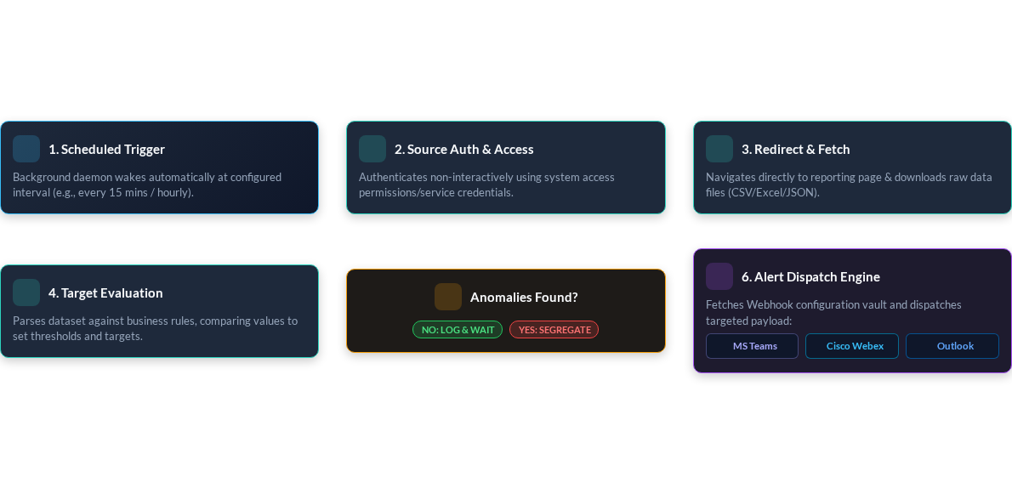
24/7 Automated Reporting & Anomaly Flowchart

Slide 3


Webhook Configuration & Channel Integration
MS Teams Webhook Setup Flow
Multi-Channel Delivery Spec
1. Group Permissioning: Obtain administrative access to target MS Teams channels.
Segregated anomalies are dispatched according to severity and configured endpoint protocols:
2. Power Automate Workflow: Create automated flow triggered by HTTP incoming requests.
Target Platform | Integration Method | Payload Format
MS Teams | Power Automate Webhook URL | Adaptive Cards / JSON
Cisco Webex | REST Webhook API | Formatted Rich Cards
Outlook | SMTP / MS Graph API | HTML Summary Digest Email
3. Webhook URL Generation: Copy unique Webhook endpoint generated by Power Automate.
4. Bot Vault Integration: Save Webhook endpoint into background runner's secure configuration file.
5. Automated Execution: Background program uses endpoint to send instant adaptive alert cards.

